Slide 1

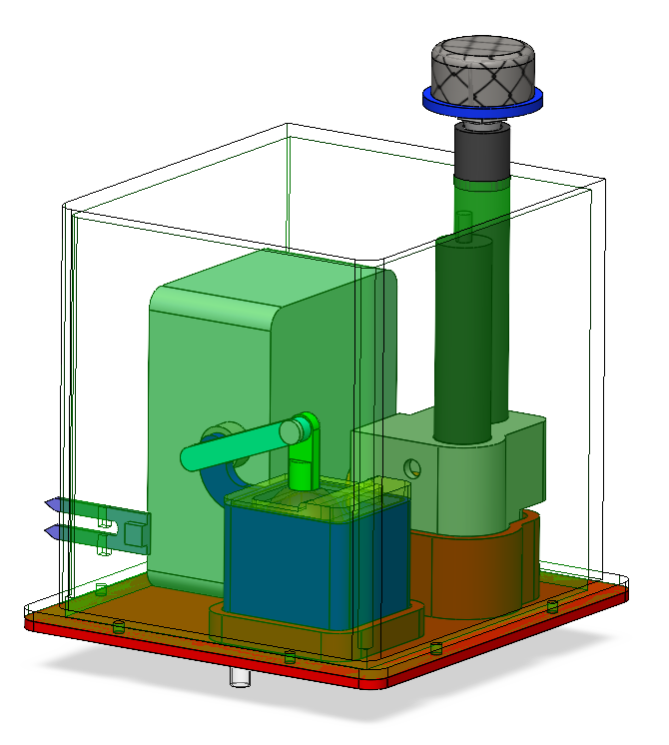
Engineers Without Borders Rainworks Project
GOAL: Improve stormwater management on flood prone areas by collecting groundwater data which will help formulate future bio-sustainability proposals and projects on the Vanderbilt Campus
Electronics box
Water inlet
- 8.8” x 8.2” x 8.2” exterior dimensions
- 3D printed and made water resistant with Silicone loctite
- Internal battery powered sensor system
- Base of mesh cap is placed flush with the ground to allow groundwater flow into the inlet
Water outlet

Slide 2
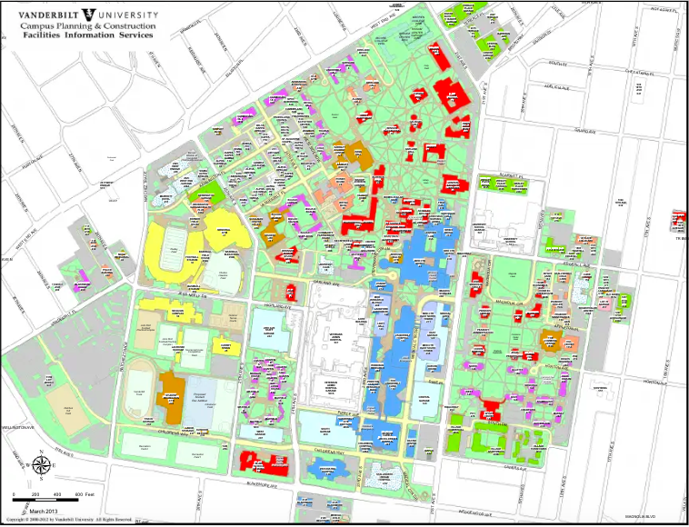
Locations
1
At the moment only one box will be placed in the ground.
Possible locations:
Outside admissions building
Bottom of Peabody Esplanade
Highland Chaffin Area
Digging will only take up a maximum of 1ftx1ft spaces within the grass, which could be supervised by maintenance.
2
3

Slide 3
Timeline
Box installed on April 20, 2025
Box removed by May 6, 2025
One sign that describes the project and requests people to avoid the area
Sign will be on an A-frame placed next to the box
There will be weekly routine check ups and maintenance by EWB members to ensure prototype functionality

Slide 4
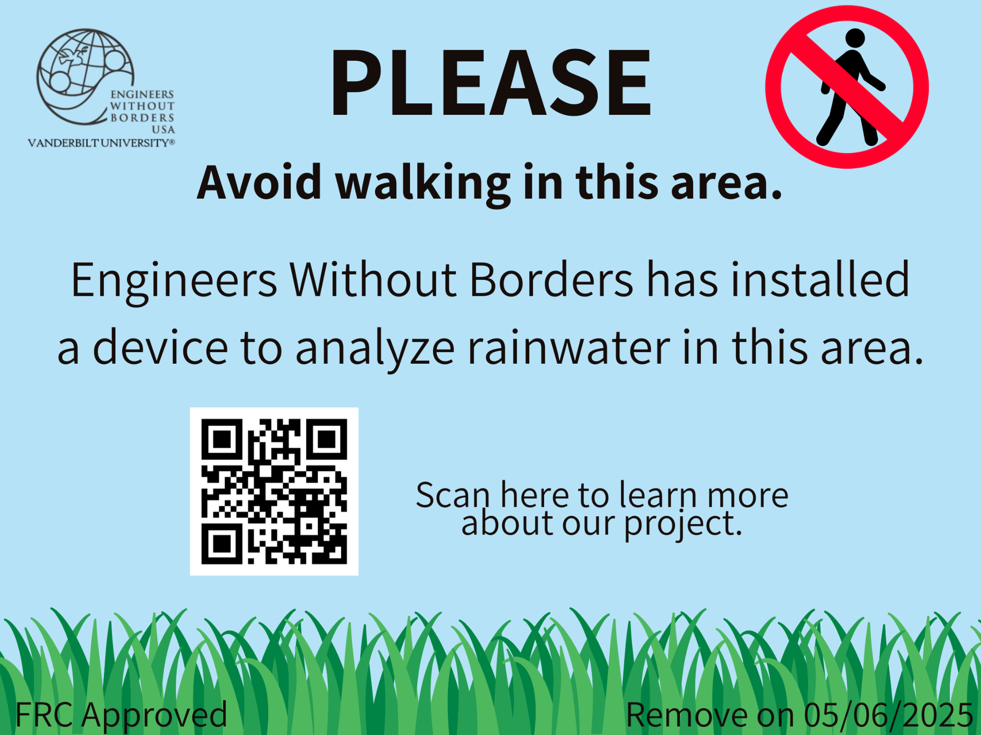
Signage

